Slide 1
NOISE POLLUTION: ITALIAN LEGISLATION
• Article n. 844 of the Italian Civil Code: relating to the normal level of tolerance to noise.
• Framework Law n. 447 of 26 October 1995: dealing with noise pollution.
• Decree of the President of the Cabinet of Ministers of 14 November 1997: setting the limits of noise level from sound sources.
• Ministerial Decree of 16 March 1998: on perceiving and measuring environmental noise levels.
• Legislative Decree n. 194 of 19 August 2005: implementing the Directive 2002/49/EC on the assessment and management of environmental noise

Slide 2
Smarthphones and apps used:
-Phones
S1 Iphone 5S
S2 Microsoft Lumia 540
-Apps
Decibel meter , ver. 3.00

Slide 11
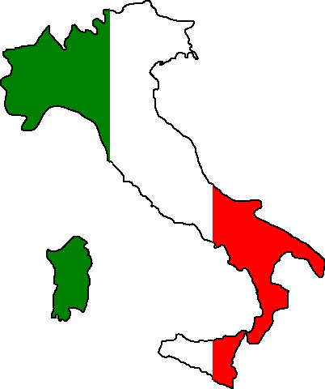
Students:
Maria Pia Maiello
Stella Grazia Mazzuoccolo
Teachers :
Anna Rita Margio
Pasquale Palluotto

